Slide 1

Wool Lab: Kool Aid Dyeing
Oh Yeah!

Slide 2
Welcome
Facilitator: Denise Mor
Shepherd, Spinner, Knitter, Sometime Weaver
My Tiny Flock: Daphne (Icelandic) Fiona (Icelandic) and Dottie (Gotland/Shetland)
Located north of Sedro Woolley
Slides Available for the foreseeable future on my website at
www.fullyfleeced.com/
Kindly assisted today by Barbara Tate
Acknowledgements: superwash wool roving supplied by Spindrifters Spinning Guild of Bellingham, WA (mill ends donated by Spincycle Yarn)

Slide 3
Why Kool Aid?
> Readily Available
> Reasonably inexpensive
> Non-Toxic
> Contains Ascorbic Acid (Vitamin C)
> Is wash-fast, and fairly light-fast, though some colors (blues, purples) tend to fade faster than yellows, reds)
Can also use liquid or paste food dyes, but need to add acid (vinegar works well) to get dye to fix.
About 1 TBS per cup of water.

Slide 4
Materials
> Wool or other animal fiber (alpaca, mohair, silk)
> Hot water
> Dishsoap
>Microwave safe dish
>Plastic wrap or ziplock bags
>Mixing containers
>Droppers/Brushes/Sponges or other applicators

Slide 5
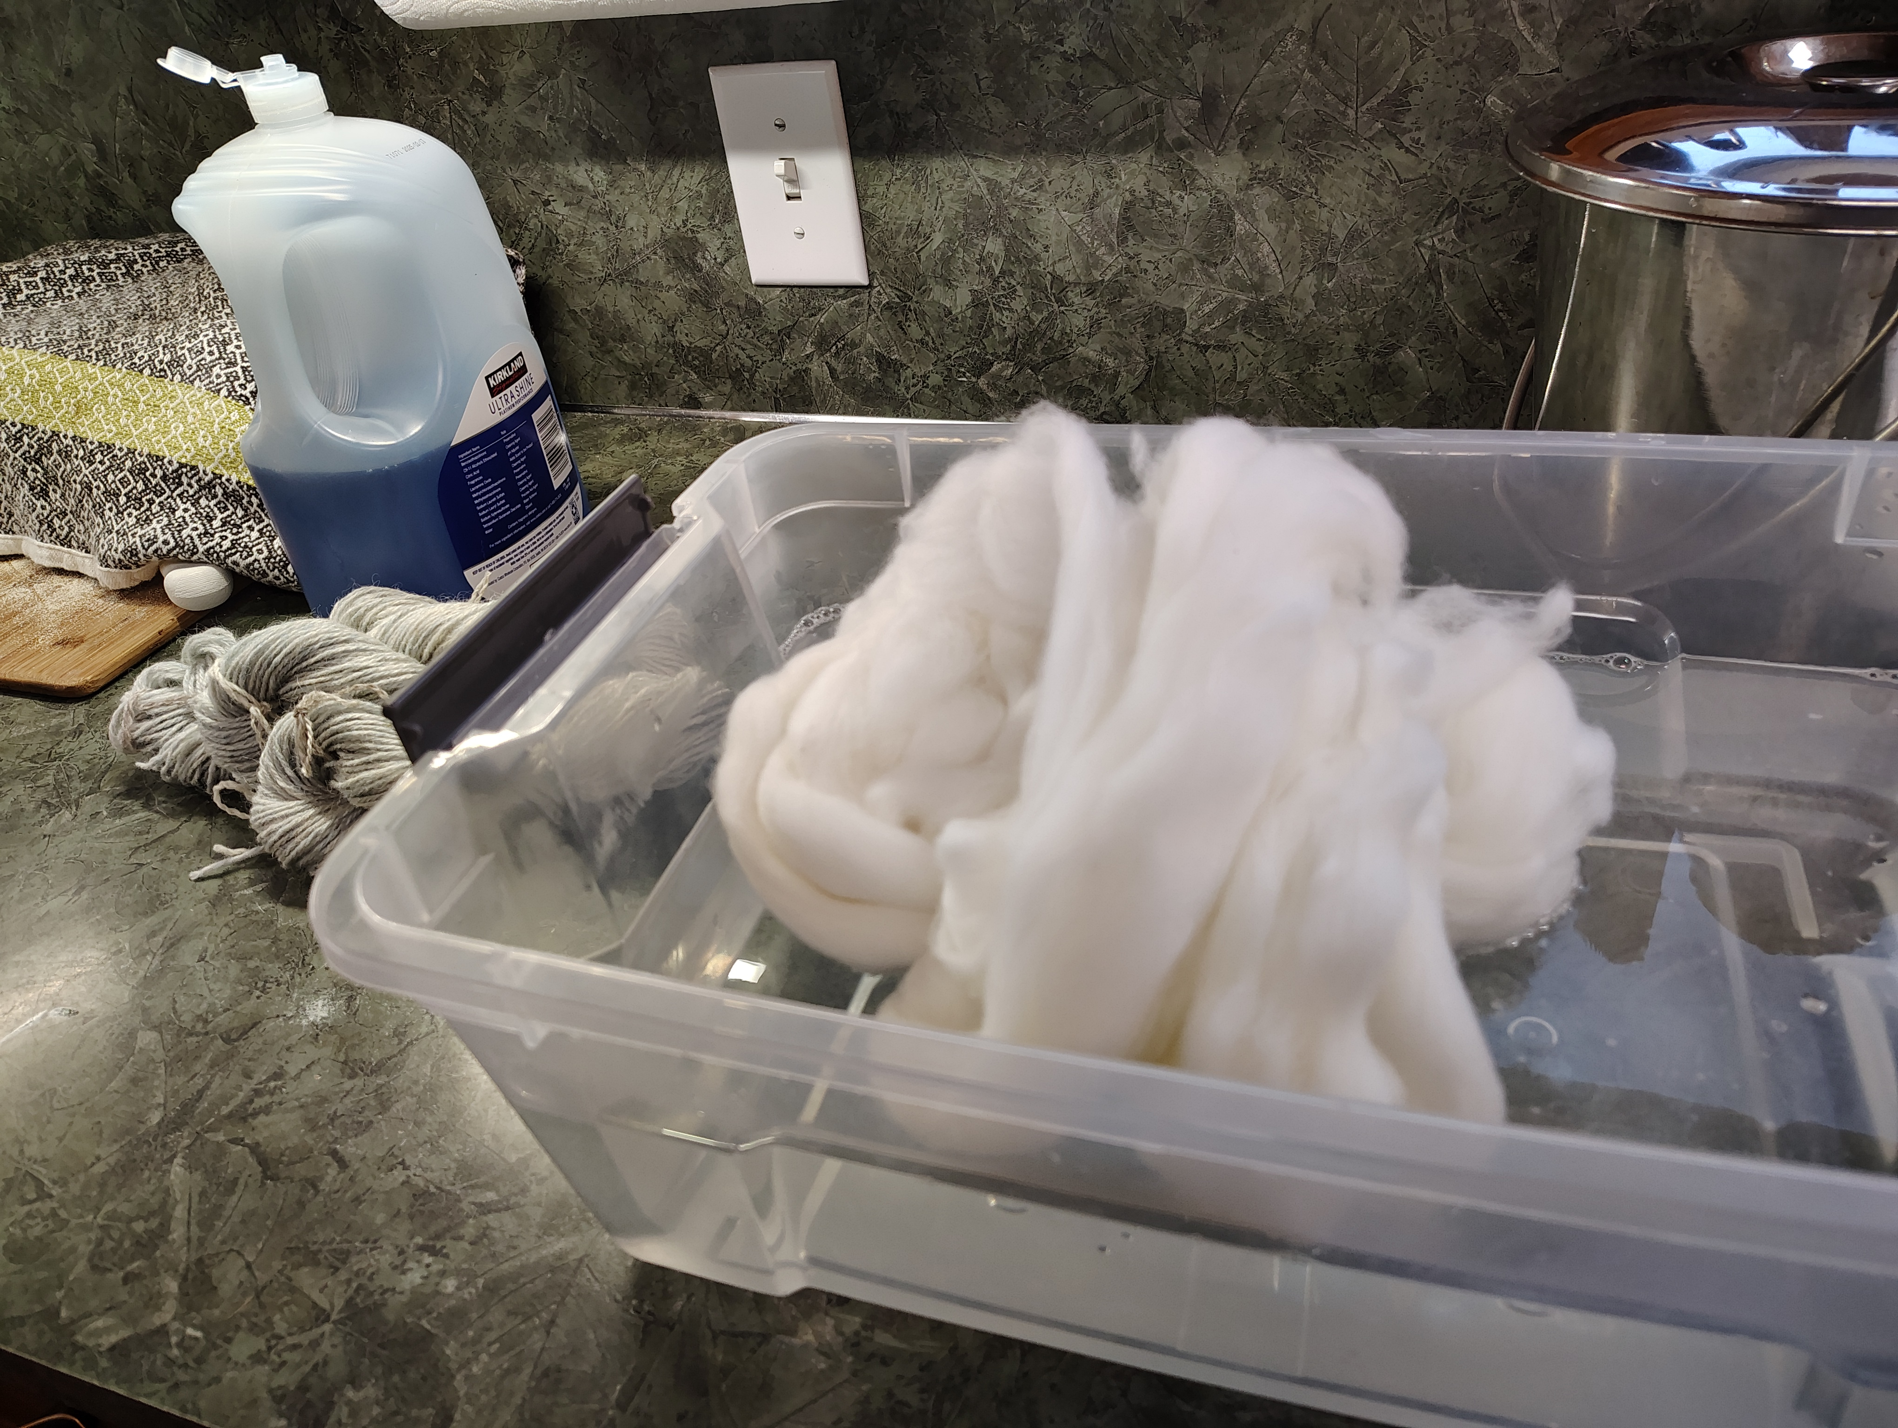
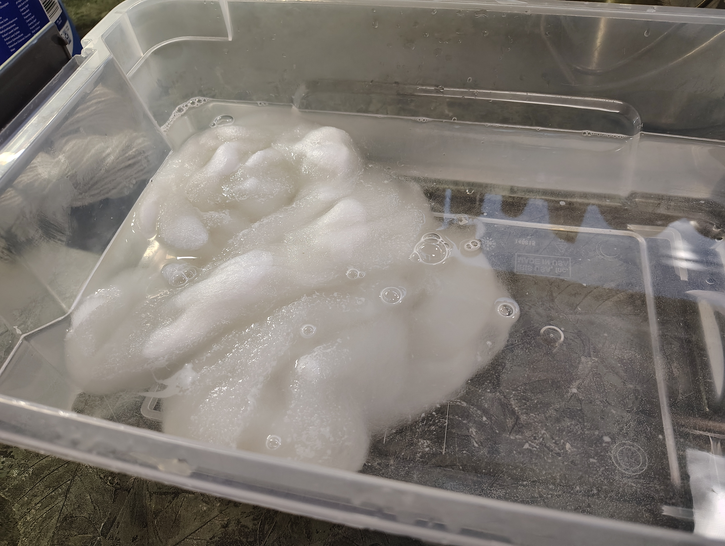
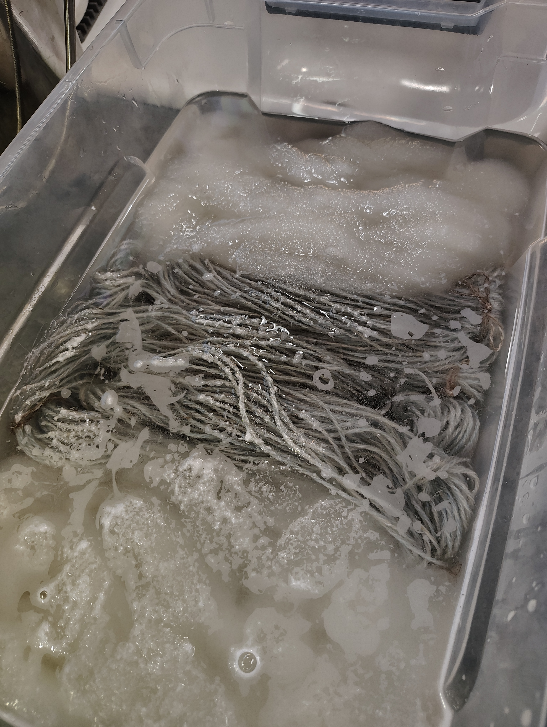
Preparation
>Wind yarn into skeins and tie loosely in 4 or more places
>Pre-wet fiber thoroughly (adding a tiny bit of dish soap to soak helps to break surface tension)

Slide 6
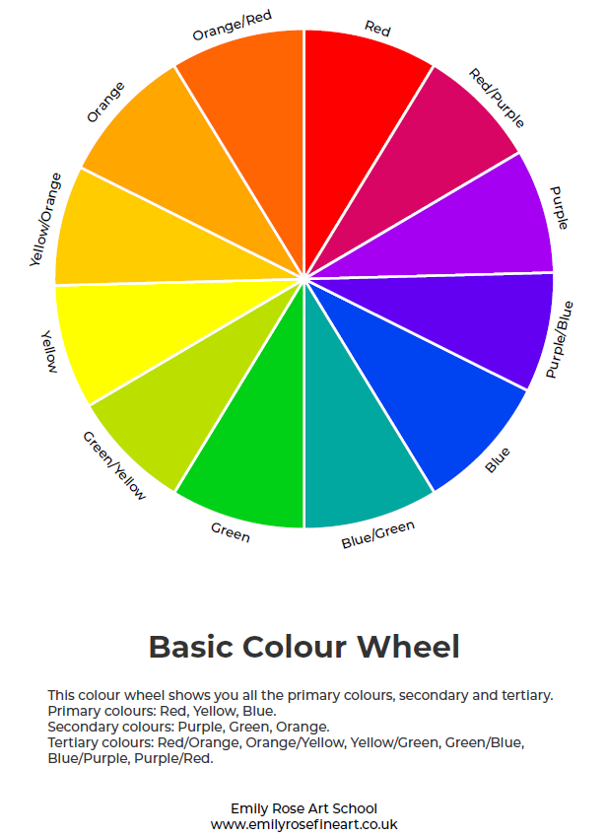
Color Theory

Slide 7
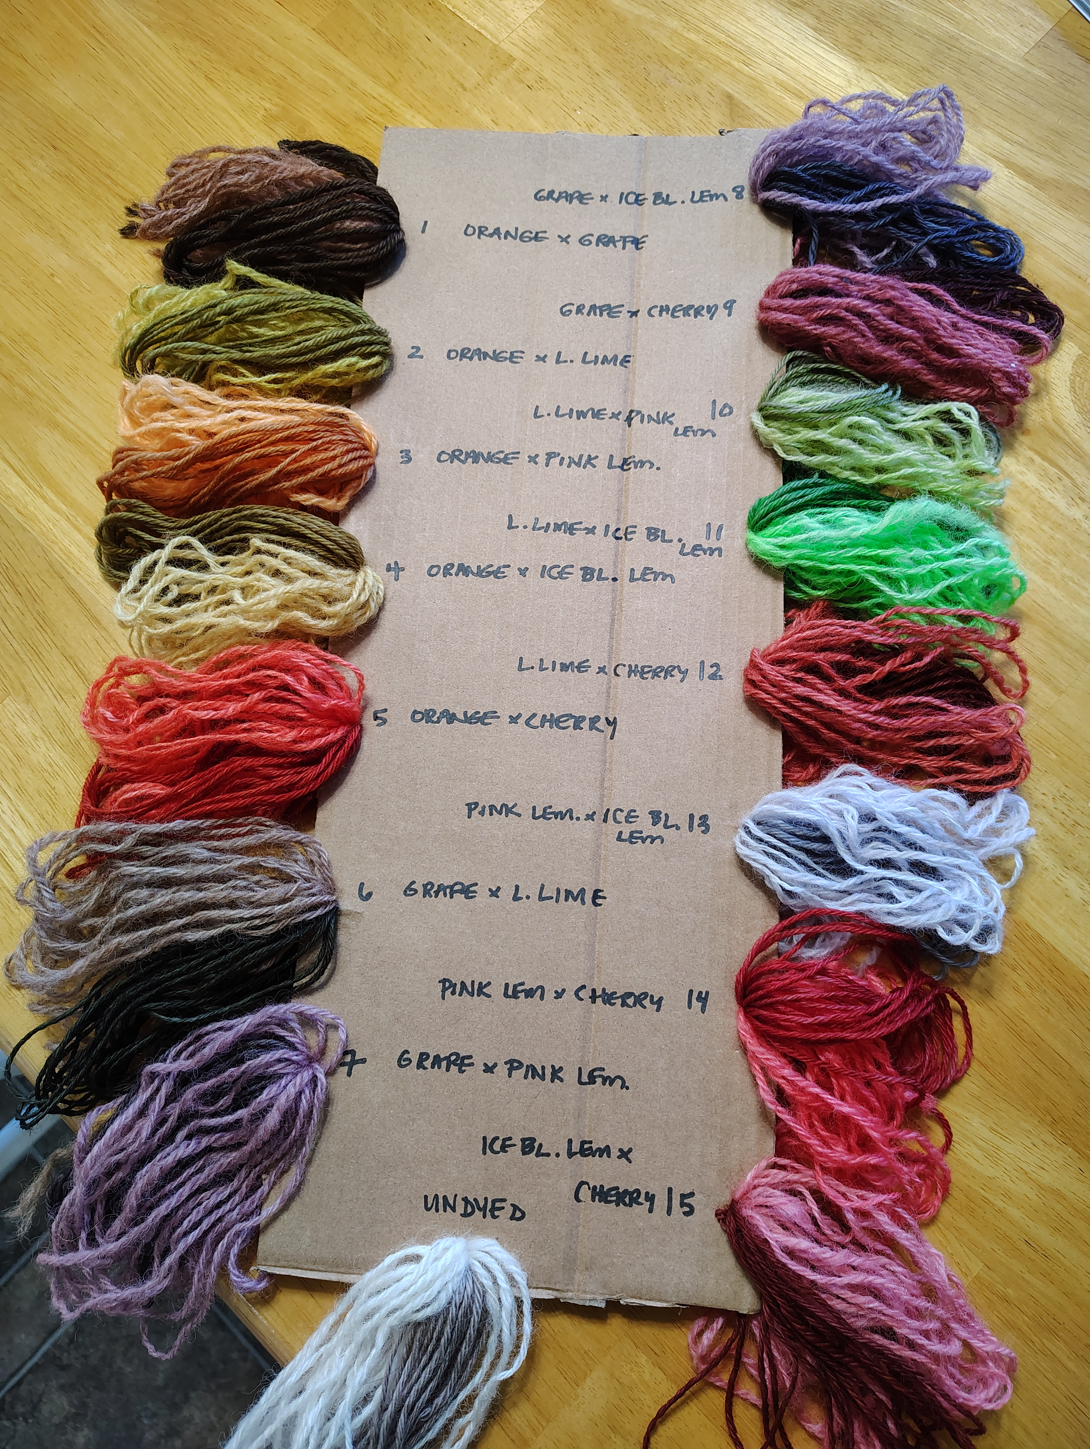
Color Mixing
Combining flavors from across the color wheel can result in exciting and appealing hues that are softer and more complex than their bold fruity ingredients!
Also, overdying beige, gray or taupe yields even darker and richer colors.

Slide 8
Variables & Techniques
Density of Color- how much total dye stuff in solution
Total amount of water- will affect how color spreads through fiber
How dye solution is applied- overall, painted, dabbed, sprinkled, etc
> Ziplock bath- semi-solid, kettle dyed
> Dipping: tonal, gradient
> Dropping: eyedropper, straw, etc– hand-painted result
> Dabbing: popsicle stick or fork- speckles, small dots
>Dry powder sprinkling: speckled or airbrushed

Slide 9
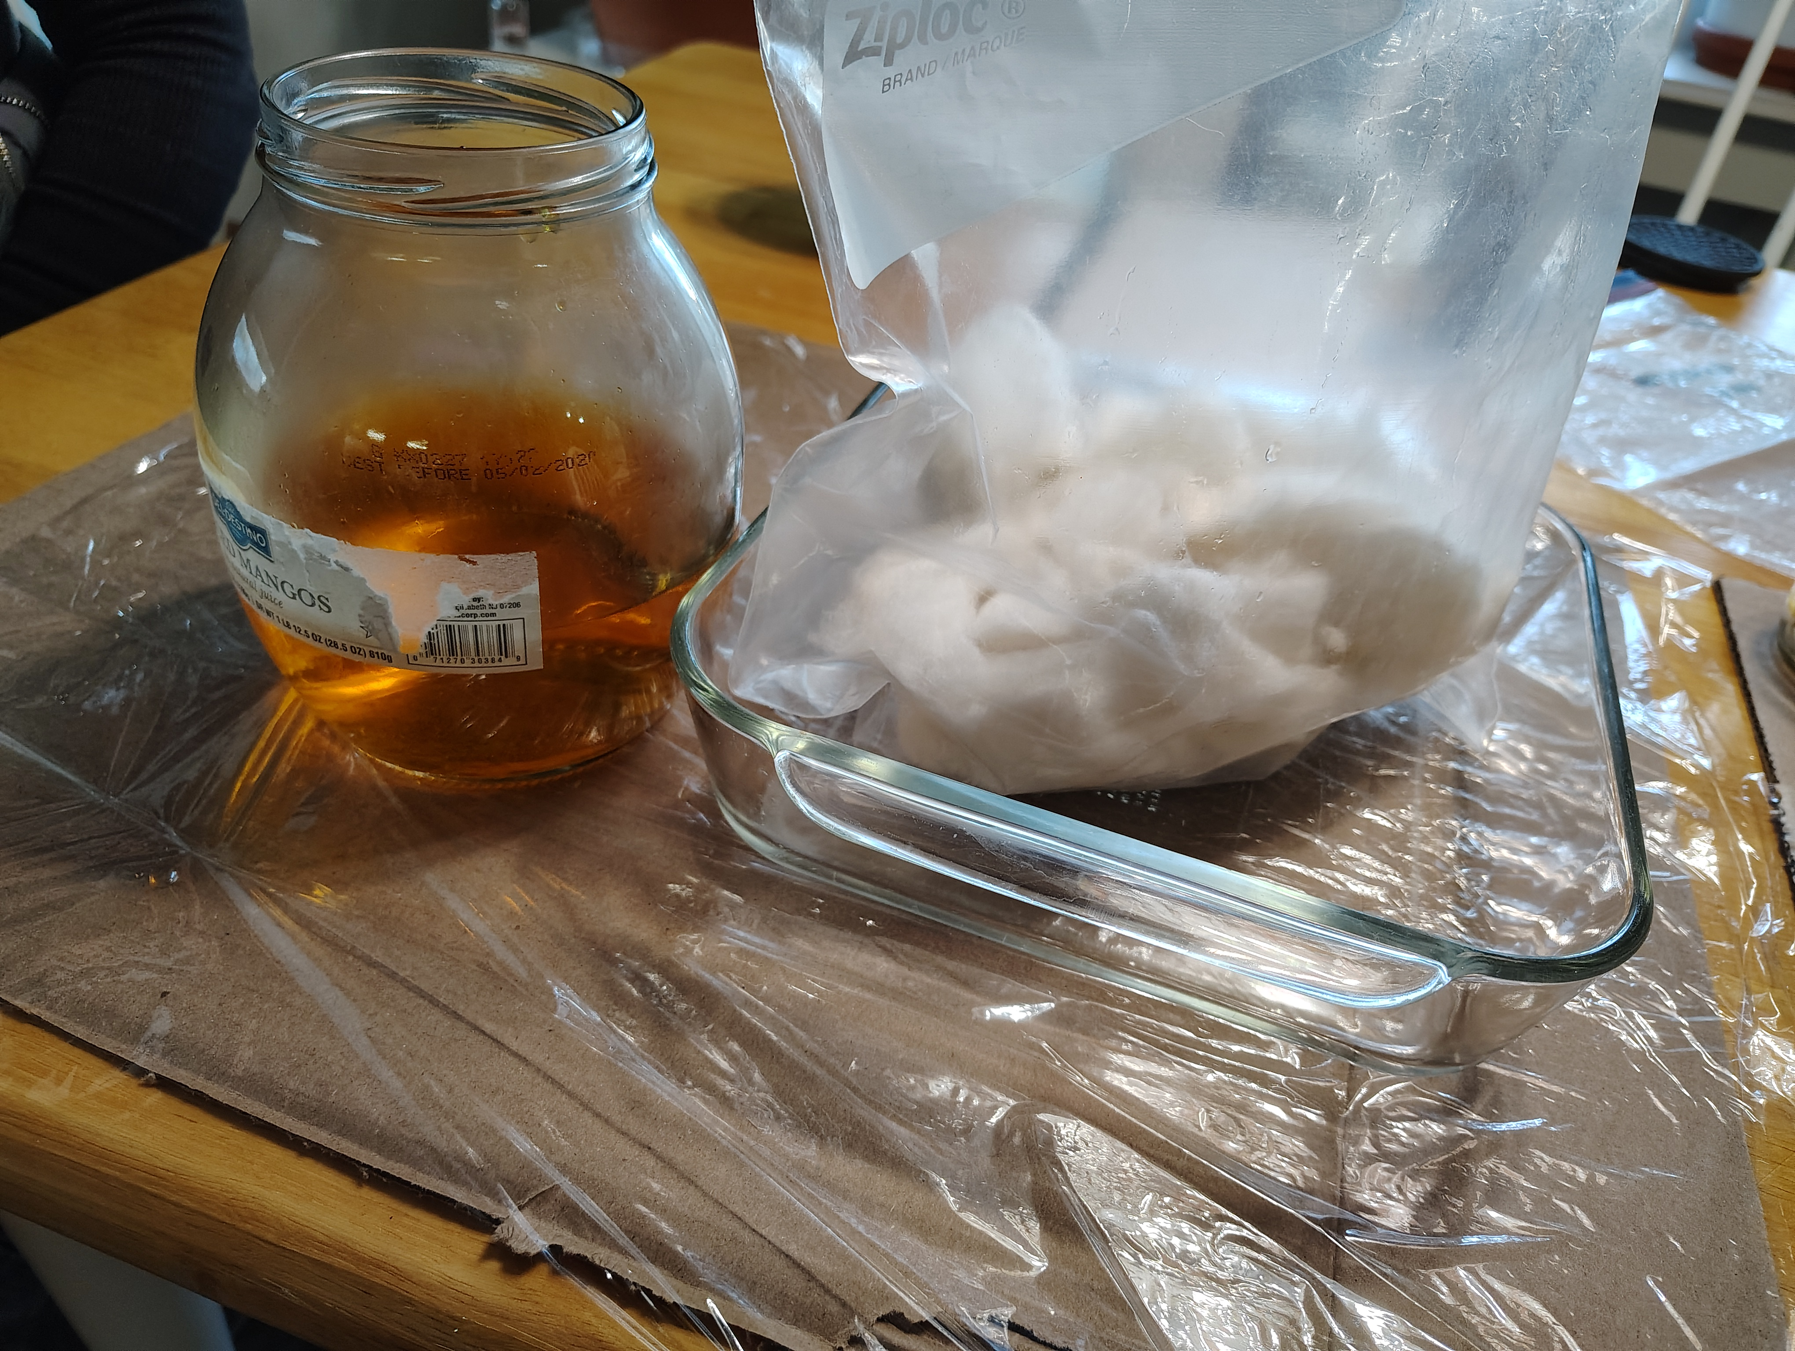
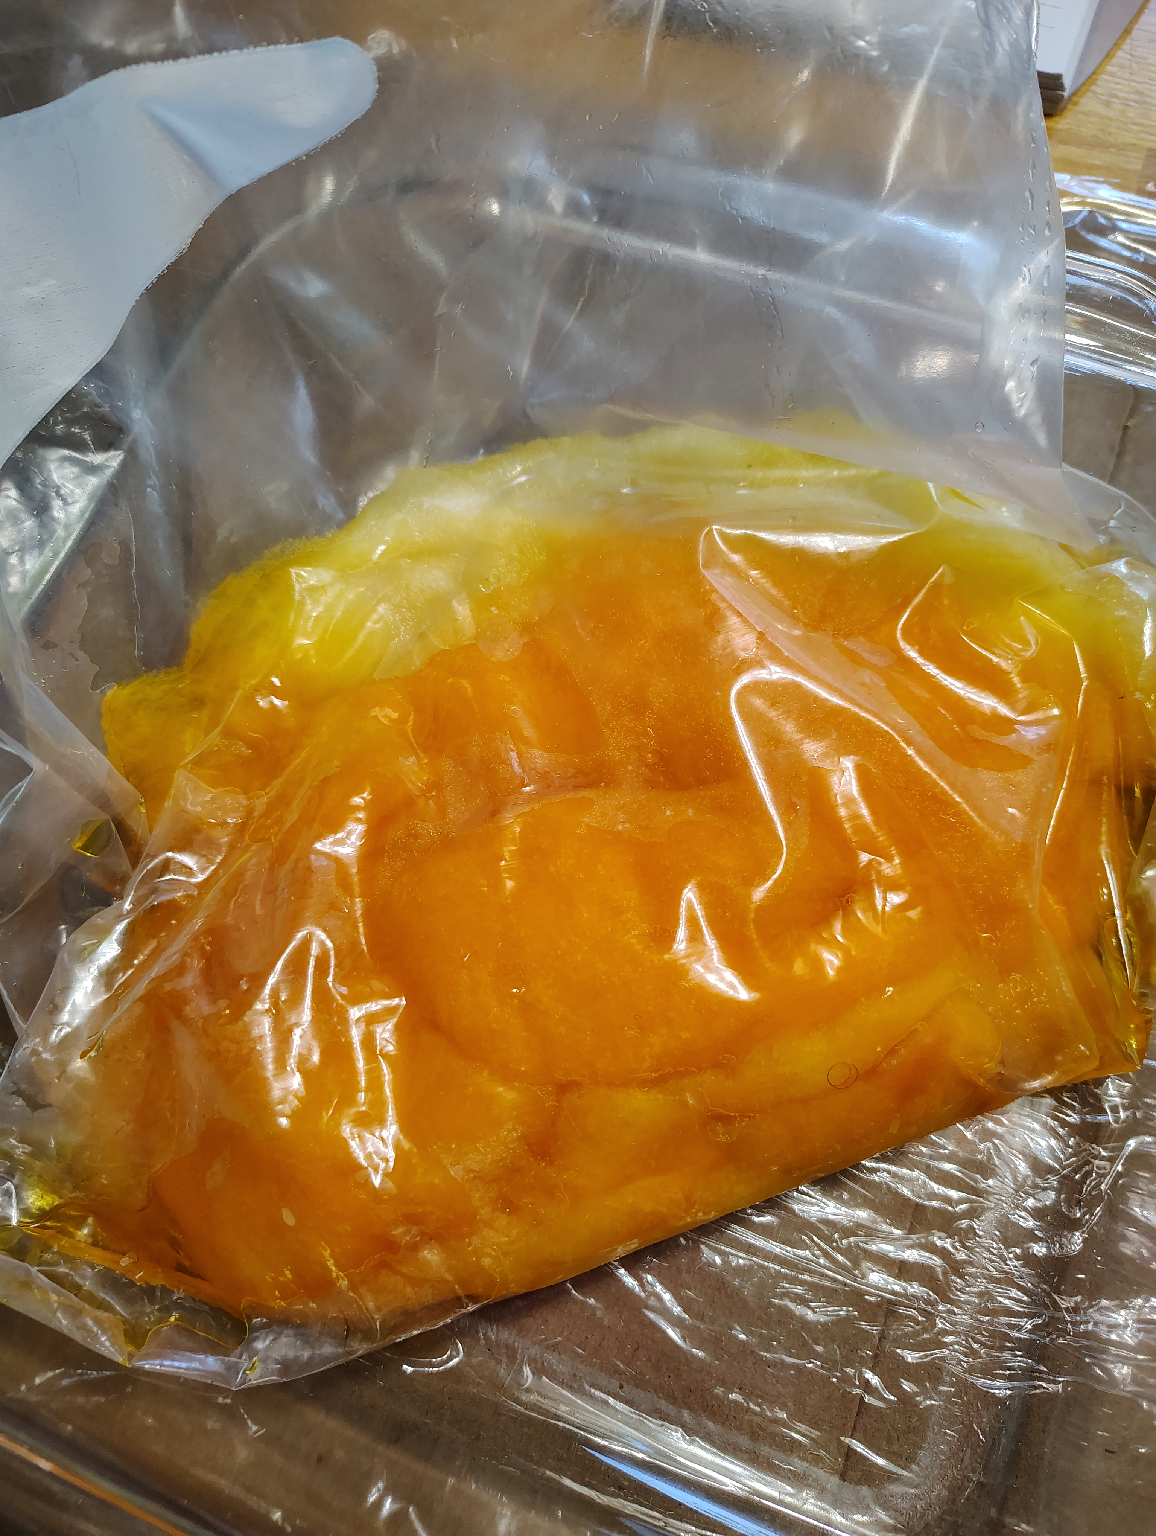
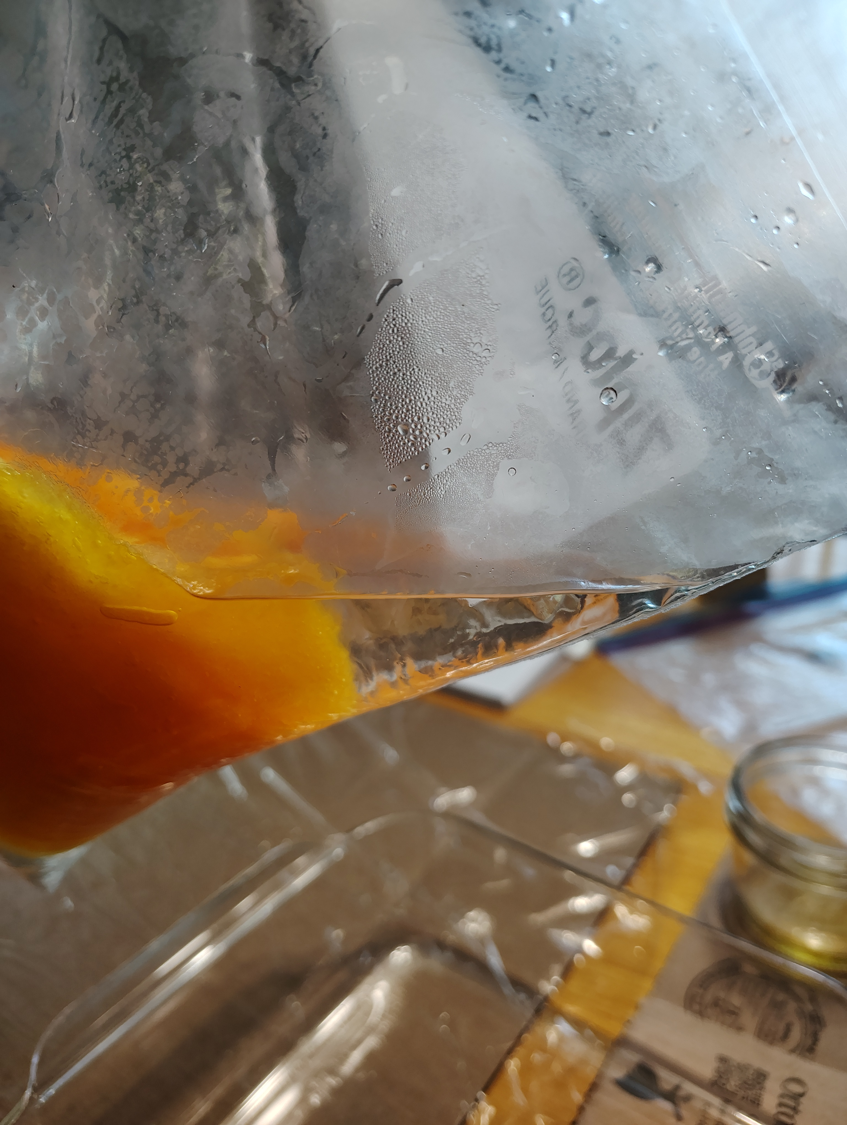
Ziplock Bath
>Dissolve Kool Aid in a small amount of hot water
>Add tepid water to achieve desired volume (enough to cover fiber completely) ((probably 2-3 cups for today’s samples))
>Add yarn or fiber to ziplock and ensure that all fiber is saturated with dye solution
>Heat to fix color (2 minute increments)
>when complete, water in bag should be colorless, or slightly milky.

Slide 10
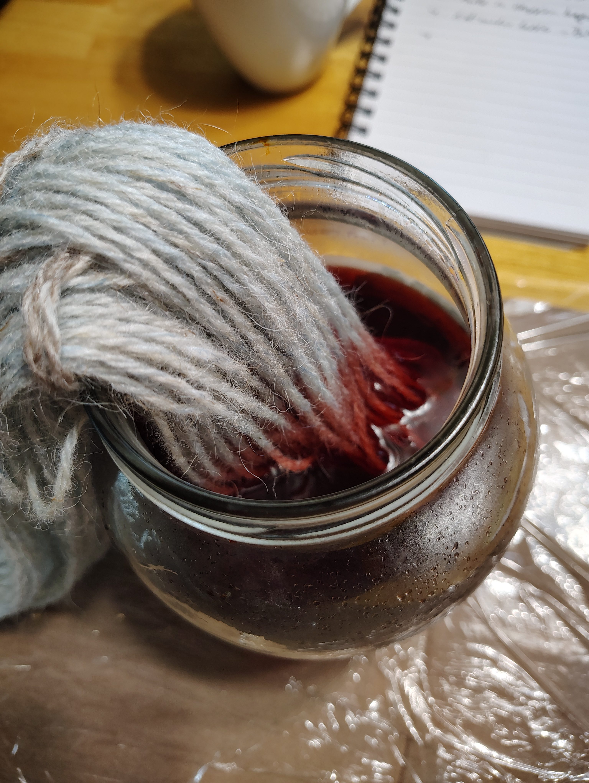
Dipping
>Dissolve Kool Aid in a small amount of hot water
>Add tepid water to achieve desired volume
>Dip skein of yarn wholly or partially in dye liquid
>Repeat as desired until color is mostly absorbed
>Wrap in plastic and heat to fix color

Slide 11
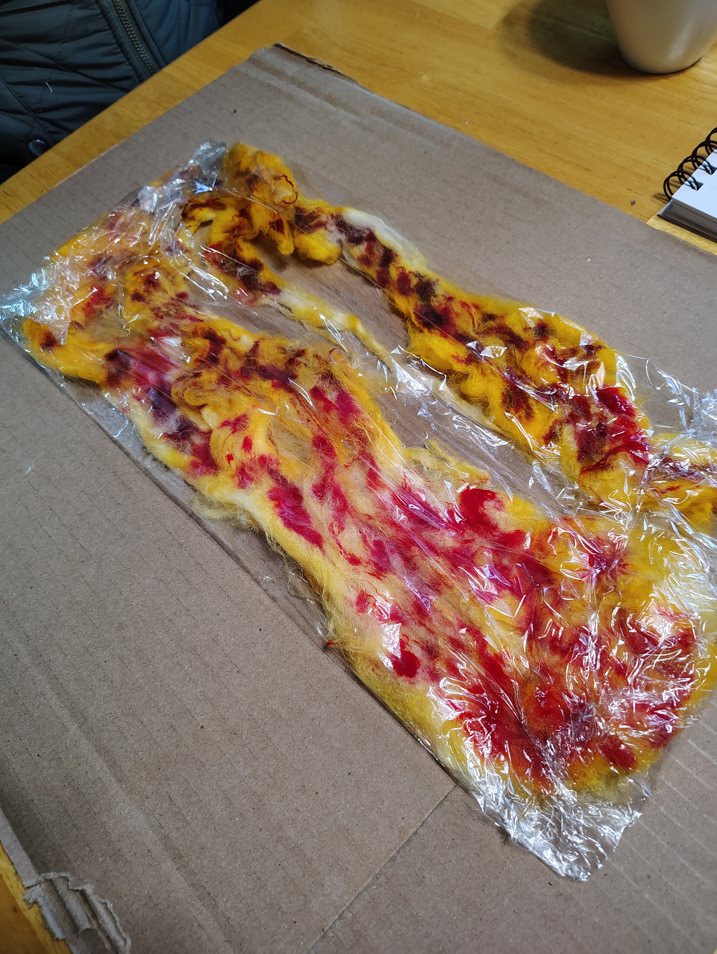
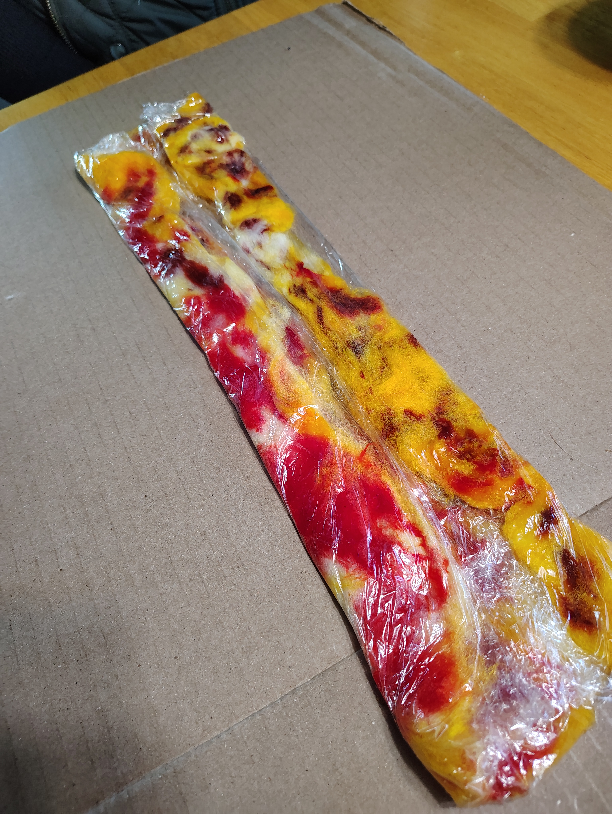
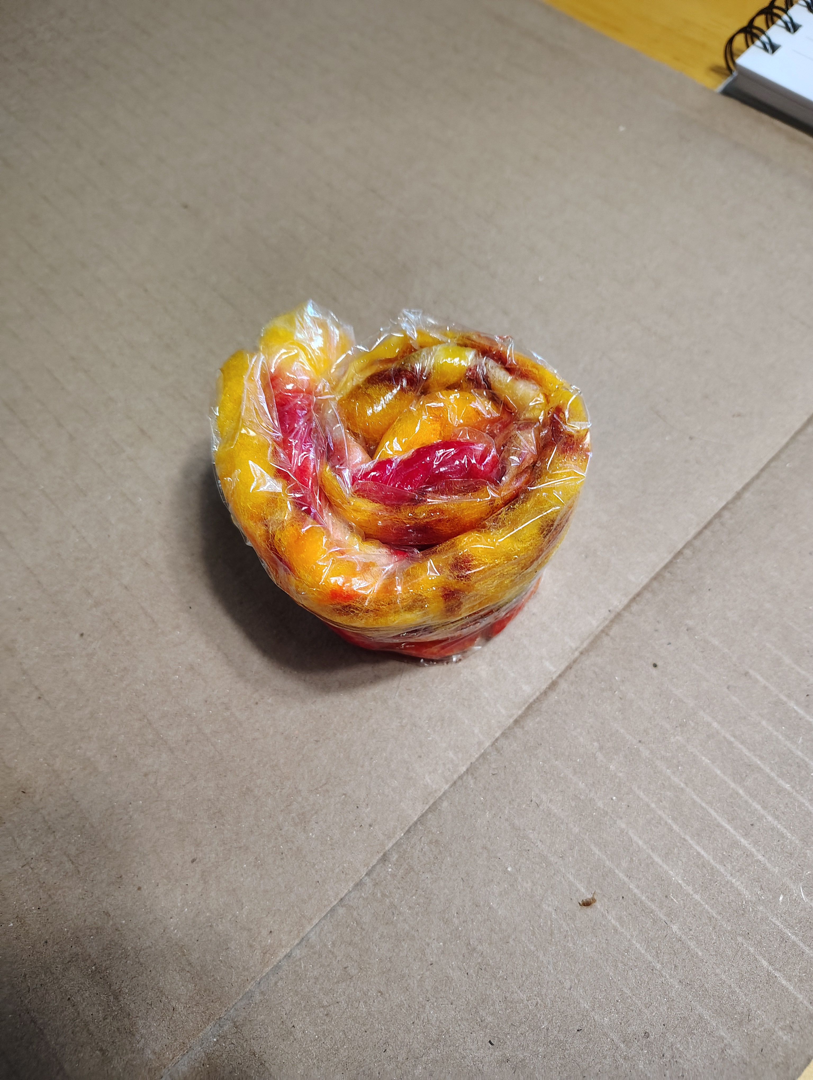
Eyedropper/Straw
>Dissolve Kool Aid in a small amount of hot water (1/3 cup or so)
>Squeeze most excess water from fiber/yarn to control spread of dye.
>Use eyedropper to distribute color on yarn or fiber
>Wrap in plastic and heat to fix color

Slide 12
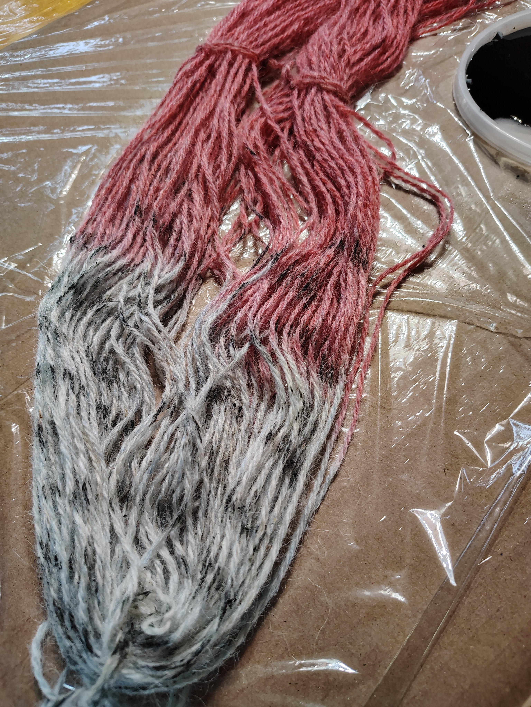
Popsicle stick / Fork
>Dissolve Kool Aid in a very small amount of hot water to make a paste(1 tsp or so)
>pick up small amounts of paste on implement and apply directly to yarn or fiber
>Wrap in plastic and heat to fix color

Slide 13
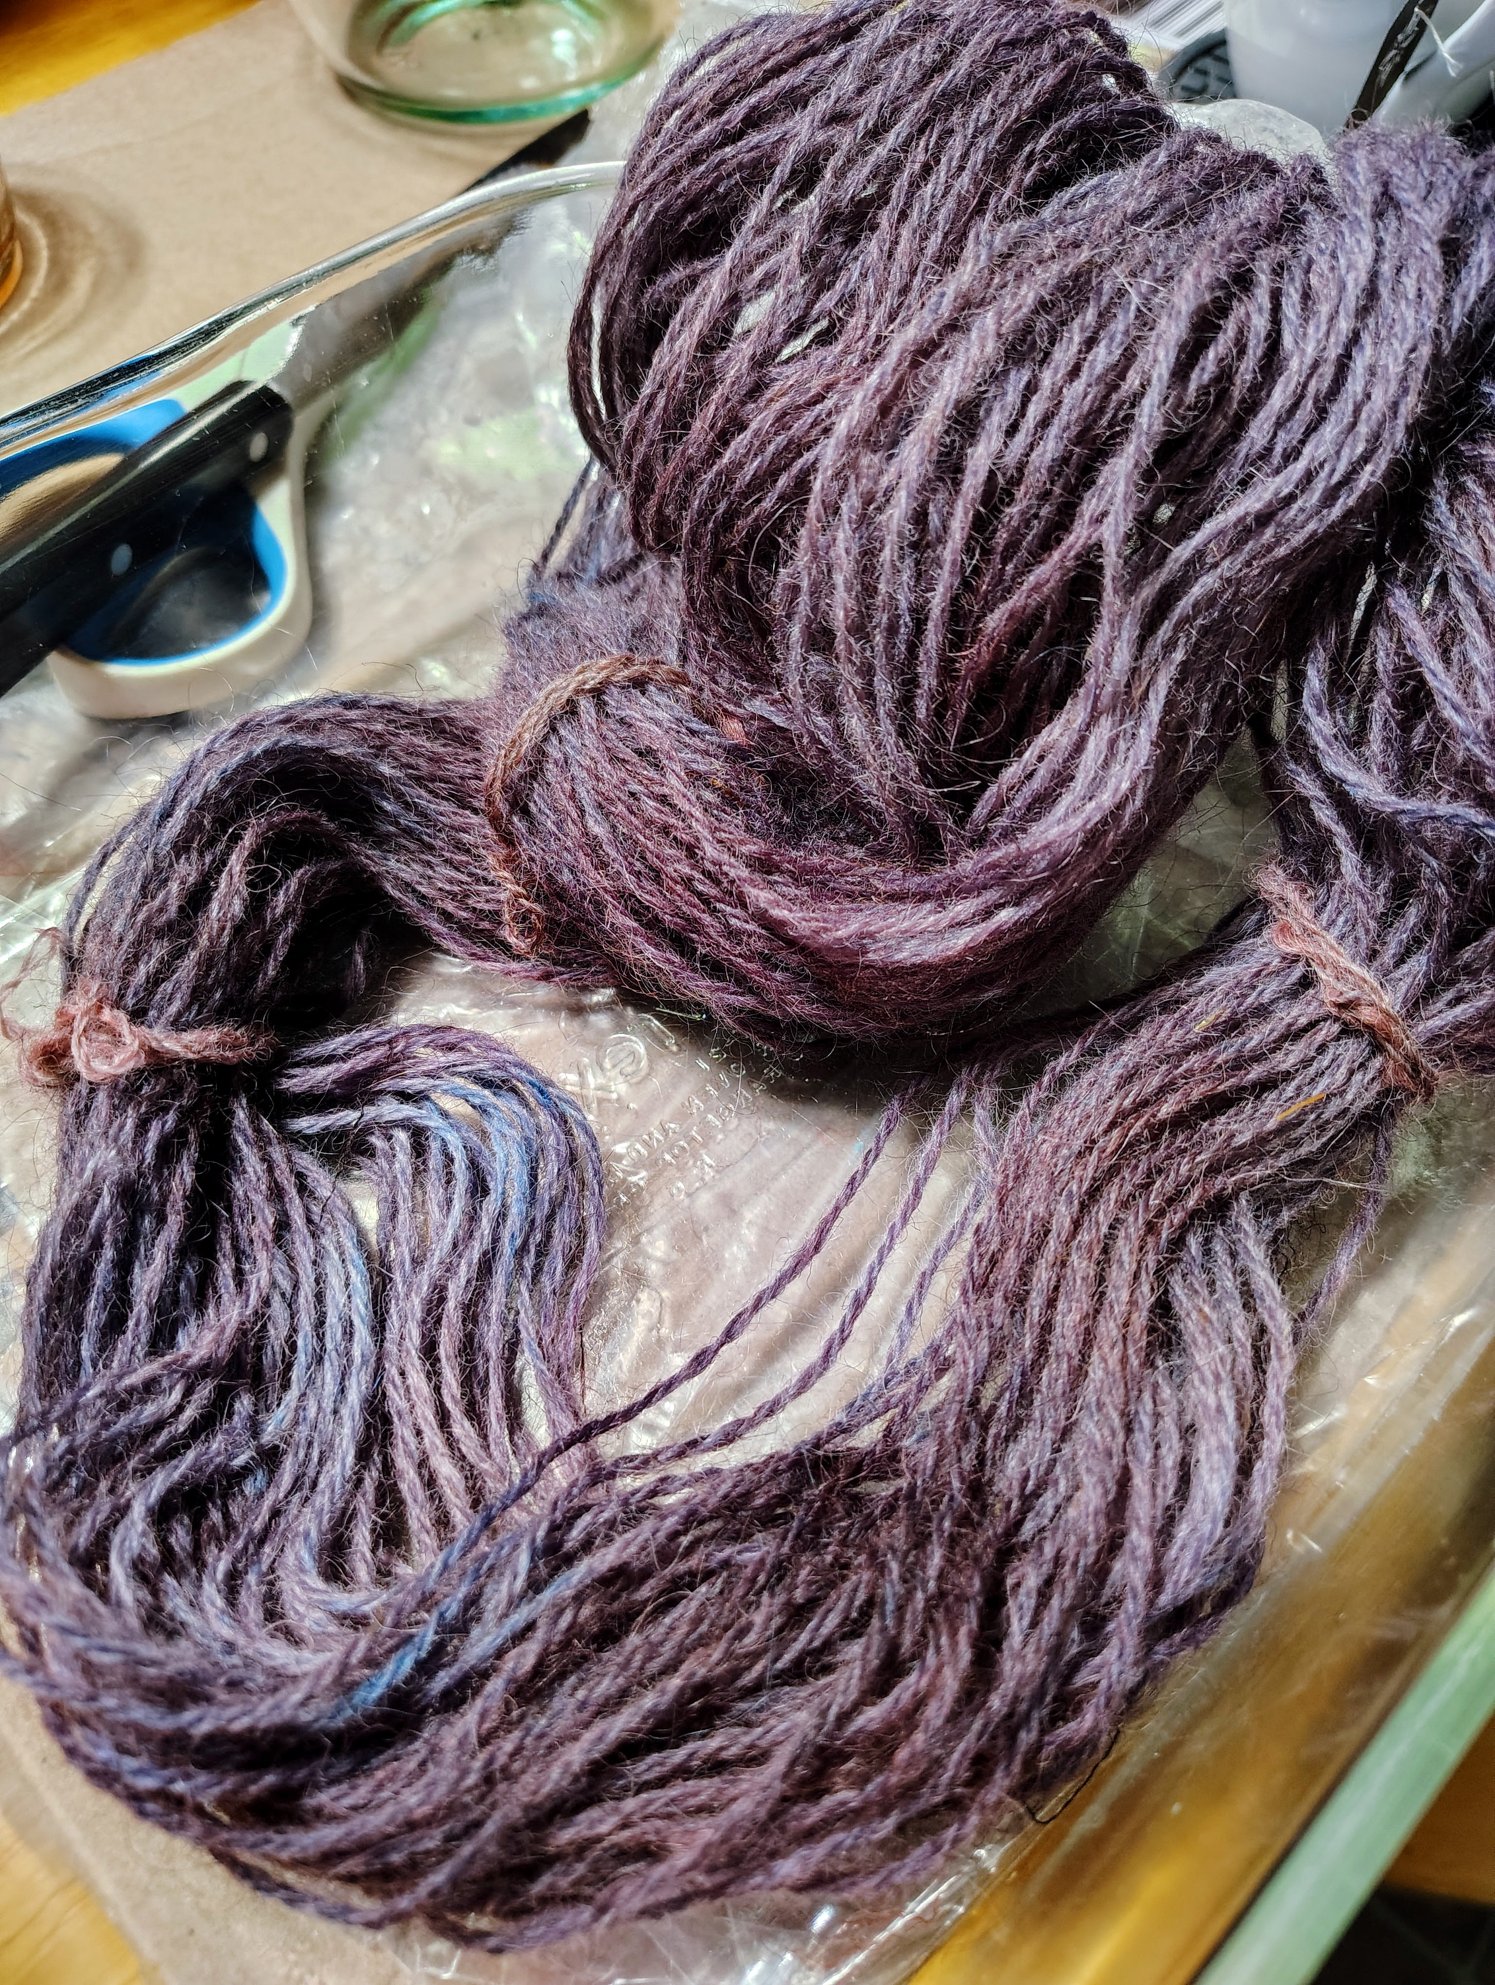
Dry Powder Sprinkling
>Use spoon to shake dry powder onto fiber or yarn
>Wrap in plastic
>Heat to fix color

Slide 14
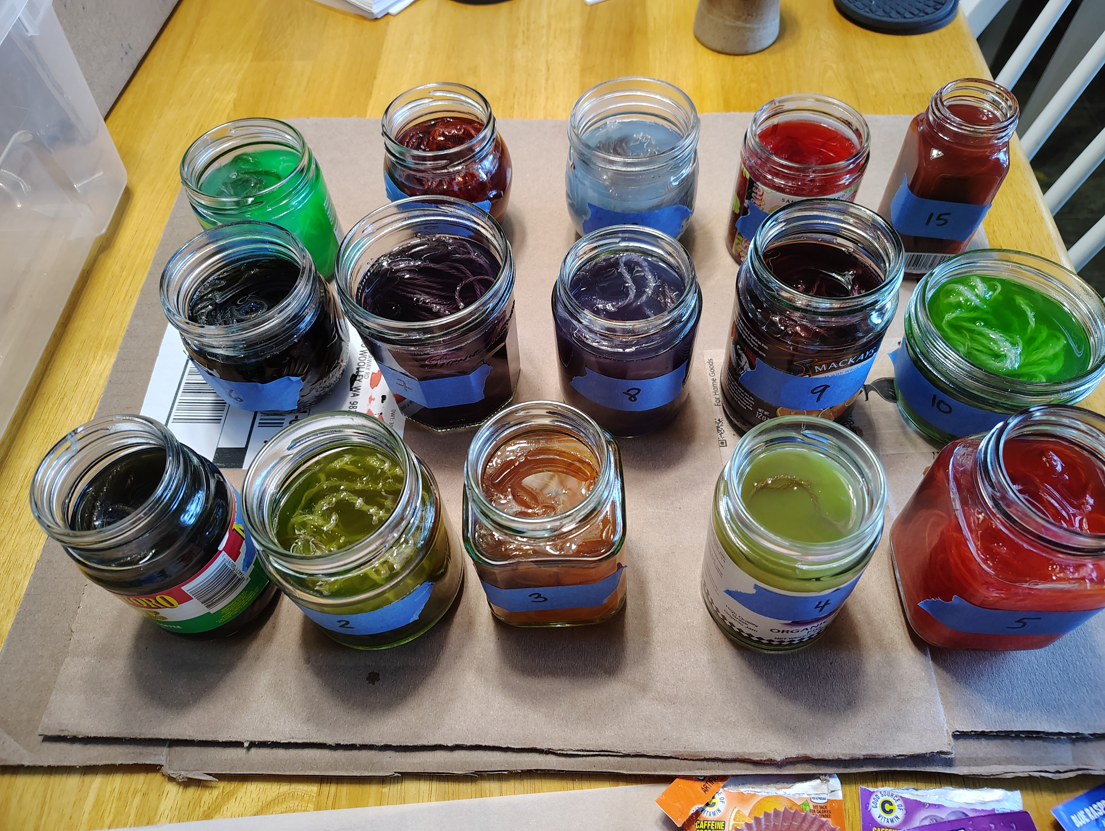
Blending, Mixing, Layering
Intermediate colors can be achieved by either:
>Mixing colors in solution-
>Layering color on fiber in separate stages
examples: Ziploc method + sprinkles of one or more colors
Dipping one color + Dipping another color
Ziplock + Hand-paint or one or more colors

Slide 15
Safety first!
> Fiber coming out of microwaves will be extremely hot
> Pressurized steam escaping from ziplock bags and plastic wrap can cause burns
For this reason, only instructors will be removing fiber parcels from microwaves.
Please let fiber cool some before handling

Slide 16
Today’s Process
>Kool Aid packets available to be diluted at different strengths
>will be using microwaves for heat source to fix dyes.
>all fiber will be sealed in either ziplock or cling wrap for heating
>please wait for items to cool before unwrapping and rinsing
>time permitting, we can apply multiple processes to each batch of fiber.

Slide 17
Important Notes
>wool roving is superwash, so no risk of felting
however,
>yarn is natural wool, so avoid abrupt temp changes or agitating while hot, as it will felt
Please be careful and do not get koolaid on clothing, as it will stain.

Slide 18
Other Resources
https://knitty.com/ISSUEwinter07/FEATfoodcolordye.html
https://amydeason.wordpress.com/2014/10/09/kool-aid-color-dye-chart/
https://www.fiberartsy.com/kool-aid-solar-over-dyeing-experiment/
https://www.fiberartsy.com/how-to-dye-yarn-with-kool-aid/

